Slide 1
Chapter 7: Securing Site-to-Site Connectivity
Connecting Networks
Notes:
Cisco Networking Academy program
Connecting Networks
Chapter 7: Securing Site-to-Site Connectivity

Slide 2
https://github.com/siagianp
https://www.youtube.com/@AmelOline/videos
https://github.com/amelcharolinesgn2/IoT_simulator-mqtt-NodeRed
github.com/amelcharolinesgn2/ANJAR

Slide 3
Chapter 7: Securing Site-to-Site Connectivity
7.1 VPNs
7.2 Site-to-Site GRE Tunnels
7.3 Introducing IPsec
7.4 Remote Access
7.5 Summary
Notes:
Chapter 7

Slide 4
Chapter 7: Objectives
After completing this chapter, students will be able to:
Describe benefits of VPN technology.
Describe site-to-site and remote access VPNs.
Describe the purpose and benefits of GRE tunnels.
Configure a site-to-site GRE tunnel.
Describe the characteristics of IPsec.
Explain how IPsec is implemented using the IPsec protocol framework.
Explain how the Anyconnect client and clientless SSL remote access VPN implementations support business requirements.
Compare IPsec and SSL remote access VPNs.
Notes:
Chapter 7 Objectives

Slide 5
Chapter 7: Introduction
Security is a concern when using the public Internet to conduct business.
Virtual Private Networks (VPNs) are used to ensure the security of data across the Internet.
A VPN is used to create a private tunnel over a public network.
Data can be secured by using encryption in this tunnel through the Internet and by using authentication to protect data from unauthorized access.
This chapter explains the concepts and processes related to VPNs, as well as the benefits of VPN implementations, and the underlying protocols required to configure VPNs.

Slide 6
7.1 VPNs
Notes:
7.1 VPNs

Slide 7
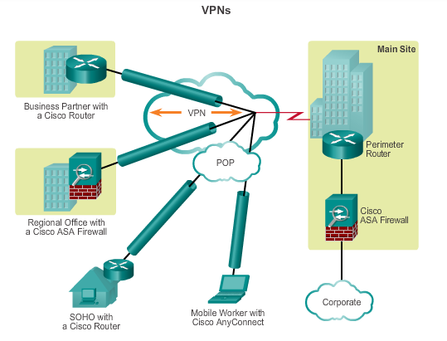
Fundamentals of VPNs Introducing VPNs
VPNs are used to create an end-to-end private network connection over third-party networks, such as the Internet or extranets.
To implement VPNs, a VPN gateway is necessary: Could be a router, a firewall, or a Cisco Adaptive Security Appliance (ASA).
Notes:
7.1.1.1 Introducing VPNs

Slide 8
Fundamentals of VPNs Benefits of VPNs
Cost savings
Enable organizations to use cost-effective, third-party Internet transport to connect remote offices and remote users to the main site.
Scalability
Enable organizations to use the Internet infrastructure within ISPs and devices, which makes it easy to add new users.
Notes:
7.1.1.2 Benefits of VPNs

Slide 9
Fundamentals of VPNs Benefits of VPNs (cont.)
Compatibility with broadband technology
Allow mobile workers and telecommuters to take advantage of high-speed, broadband connectivity, such as DSL and cable, to gain access to the networks of their organization, providing workers flexibility and efficiency.
Provide a cost-effective solution for connecting remote offices.
Security
Can include security mechanisms that provide the highest level of security by using advanced encryption and authentication protocols that protect data from unauthorized access.
Notes:
7.1.1.2 Benefits of VPNs

Slide 10
Types of VPNs Site-to-Site VPNs
Connect entire networks to each other, in the past, a leased line or Frame Relay connection was required to connect sites, but because most corporations now have Internet access, these connections can be replaced with site-to-site VPNs.
Internal hosts have no knowledge that a VPN exists.
Created when devices on both sides of the VPN connection are aware of the VPN configuration in advance.
Notes:
7.1.2.1 Site-to-Site VPNs

Slide 11
Types of VPNs Site-to-Site VPNs (cont.)
End hosts send and receive normal TCP/IP traffic through a VPN gateway.
The VPN gateway is responsible for encapsulating and encrypting outbound traffic for all traffic from a particular site
The VPN gateway then sends it through a VPN tunnel over the Internet to a peer VPN gateway at the target site.
Upon receipt, the peer VPN gateway strips the headers, decrypts the content, and relays the packet toward the target host inside its private network.
Notes:
7.1.2.1 Site-to-Site VPNs

Slide 12
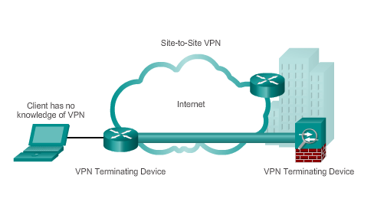
Types of VPNs Site-to-Site VPNs (cont.)
Notes:
7.1.2.1 Site-to-Site VPNs

Slide 13
Types of VPNs Remote Access VPNs
Support the needs of telecommuters, mobile users, and extranet, consumer-to-business traffic.
Support a client/server architecture, where the VPN client (remote host) gains secure access to the enterprise network via a VPN server device at the network edge.
Used to connect individual hosts that must access their company network securely over the Internet.
VPN client software may need to be installed on the mobile user’s end device (Cisco AnyConnect Secure Mobility Client).
When the host tries to send any traffic, the VPN Client software encapsulates and encrypts this traffic and sends over the Internet to the VPN gateway at the edge of the target network.
Notes:
7.1.2.2 Remote Access VPNs

Slide 14
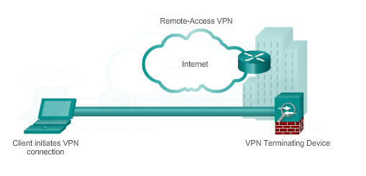
Types of VPNs Remote Access VPNs (cont.)
Notes:
7.1.2.2 Remote Access VPNs

Slide 15
7.2 Site-to-Site GRE Tunnels
Notes:
7.2 Site-to-Site GRE Tunnels

Slide 16
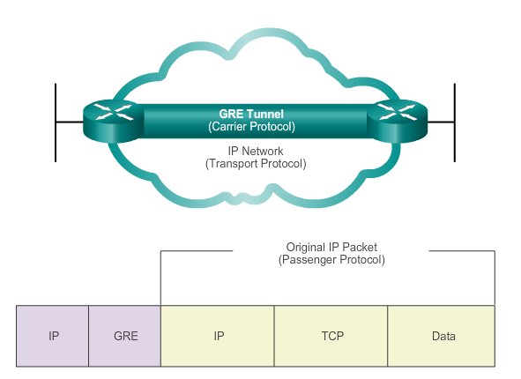
Fundamentals of Generic Routing Encapsulation Introduction to GRE
Basic, non-secure, site-to-site VPN tunneling protocol developed by Cisco
Encapsulates a wide variety of protocol packet types inside IP tunnels
Creates a virtual point-to-point link to routers at remote points, over an IP internetwork
Notes:
7.2.1.1 Introduction to GRE

Slide 17
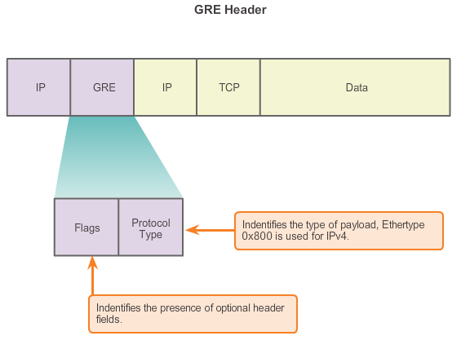
Fundamentals of Generic Routing Encapsulation Characteristics of GRE
Notes:
7.2.1.2 Characteristics of GRE

Slide 18
Fundamentals of Generic Routing Encapsulation Characteristics of GRE
GRE has these characteristics:
GRE is defined as an IETF standard.
IP protocol 47 is used to identify GRE packets.
GRE encapsulation uses a protocol type field in the GRE header to support the encapsulation of any OSI Layer 3 protocol.
GRE itself is stateless; it does not include any flow-control mechanisms, by default.
GRE does not include any strong security mechanisms to protect its payload.
The GRE header, together with the tunneling IP header, creates at least 24 bytes of additional overhead for tunneled packets.
Notes:
7.2.1.2 Characteristics of GRE

Slide 19
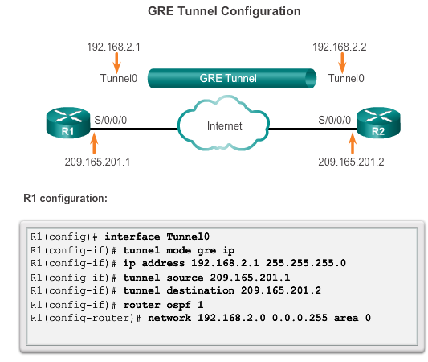
Configuring GRE Tunnels GRE Tunnel Configuration
Notes:
7.2.2.1 GRE Tunnel Configuration

Slide 20
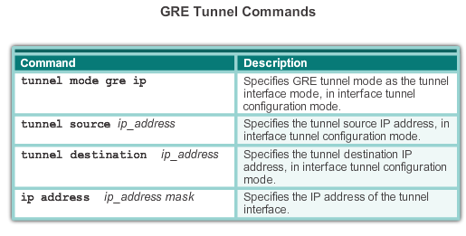
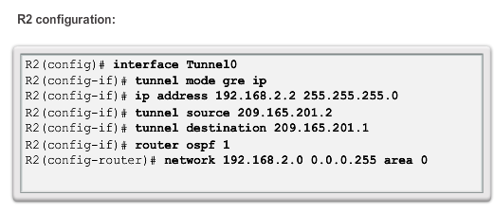
Configuring GRE Tunnels GRE Tunnel Configuration
Notes:
7.2.2.1 GRE Tunnel Configuration

Slide 21
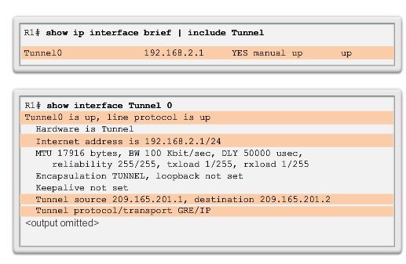
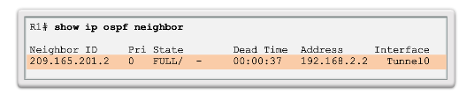
Configuring GRE Tunnels GRE Tunnel Verification
Verify Tunnel
Interface is Up
Verify OSPF Adjacency
Notes:
7.2.2.2 GRE Tunnel Verification

Slide 22
7.3 Introducing IPsec
Notes:
7.3 Introducing IPsec

Slide 23
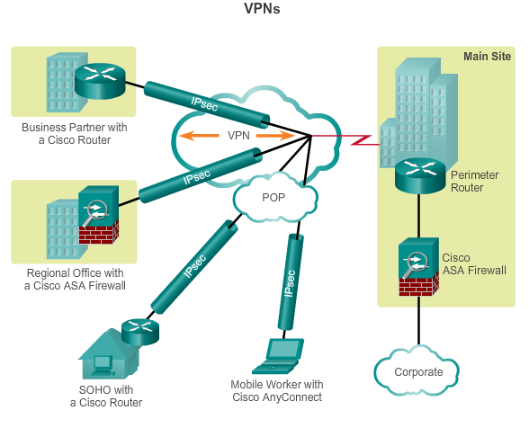
Internet Protocol Security IPsec VPNs
Information from a private network is securely transported over a public network.
Forms a virtual network instead of using a dedicated Layer 2 connection.
To remain private, the traffic is encrypted to keep the data confidential.
Notes:
7.3.1.1 IPsec

Slide 24
Internet Protocol Security IPsec Functions
Defines how a VPN can be configured in a secure manner using IP.
Framework of open standards that spells out the rules for secure communications.
Not bound to any specific encryption, authentication, security algorithms, or keying technology.
Relies on existing algorithms to implement secure communications.
Works at the network layer, protecting and authenticating IP packets between participating IPsec devices.
Secures a path between a pair of gateways, a pair of hosts, or a gateway and host.
All implementations of IPsec have a plaintext Layer 3 header, so there are no issues with routing.
Functions over all Layer 2 protocols, such as Ethernet, ATM, or Frame Relay.
Notes:
7.3.1.1 IPsec

Slide 25
Internet Protocol Security IPsec Characteristics
IPsec characteristics can be summarized as follows:
IPsec is a framework of open standards that is algorithm-independent.
IPsec provides data confidentiality, data integrity, and origin authentication.
IPsec acts at the network layer, protecting and authenticating IP packets.
Notes:
7.3.1.1 IPsec

Slide 26
Internet Protocol Security IPsec Security Services
Confidentiality (encryption) – encrypt the data before transmitting across the network
Data integrity – verify that data has not been changed while in transit, if tampering is detected, the packet is dropped
Authentication – verify the identity of the source of the data that is sent, ensures that the connection is made with the desired communication partner, IPsec uses Internet Key Exchange (IKE) to authenticate users and devices that can carry out communication independently.
Anti-Replay Protection – detect and reject replayed packets and helps prevent spoofing
CIA: confidentiality, integrity, and authentication
Notes:
7.3.1.2 IPsec Security Services

Slide 27
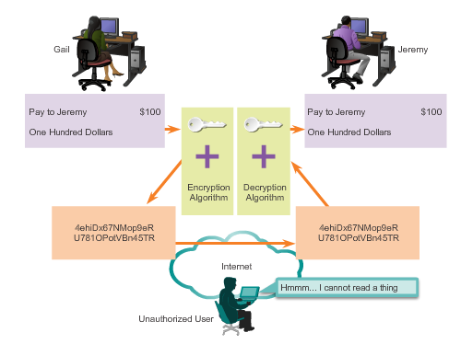
IPsec Framework Confidentiality with Encryption
For encryption to work, both the sender and the receiver must know the rules used to transform the original message into its coded form.
Rules are based on algorithms and associated keys.
Decryption is extremely difficult (or impossible) without the correct key.
Notes:
7.3.2.1 Confidentiality with Encryption

Slide 28
IPsec Framework Encryption Algorithms
As key length increases, it becomes more difficult to break the encryption. However, a longer key requires more processor resources when encrypting and decrypting data.
Two main types of encryption are:
Symmetric Encryption
Asymmetric Encryption
Notes:
7.3.2.2 Encryption Algorithms

Slide 29
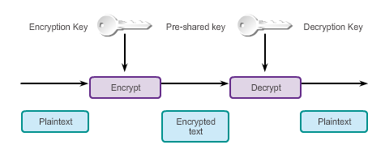
IPsec Framework Symmetric Encryption
Encryption and decryption use the same key.
Each of the two networking devices must know the key to decode the information.
Each device encrypts the information before sending it over the network to the other device.
Typically used to encrypt the content of the message.
Examples: DES and 3DES (no longer considered secure) and AES (256-bit recommended for IPsec encryption).
Notes:
7.3.2.2 Encryption Algorithms

Slide 30
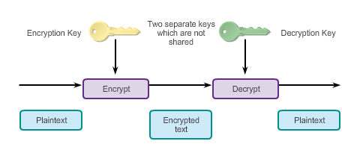
IPsec Framework Asymmetric Encryption
Uses different keys for encryption and decryption.
Knowing one of the keys does not allow a hacker to deduce the second key and decode the information.
One key encrypts the message, while a second key decrypts the message.
Public key encryption is a variant of asymmetric encryption that uses a combination of a private key and a public key.
Typically used in digital certification and key management
Example: RSA
Notes:
7.3.2.2 Encryption Algorithms

Slide 31
IPsec Framework Diffie-Hellman Key Exchange
Diffie-Hellman (DH) is not an encryption mechanism and is not typically used to encrypt data.
DH is a method to securely exchange the keys that encrypt data.
DH algorithms allow two parties to establish a shared secret key used by encryption and hash algorithms.
DH is part of the IPsec standard.
Encryption algorithms, such as DES, 3DES, and AES, as well as the MD5 and SHA-1 hashing algorithms, require a symmetric, shared secret key to perform encryption and decryption.
DH algorithm specifies a public key exchange method that provides a way for two peers to establish a shared secret key that only they know, although they are communicating over an insecure channel.
Notes:
7.3.2.3 Diffie-Hellman Key Exchange

Slide 32
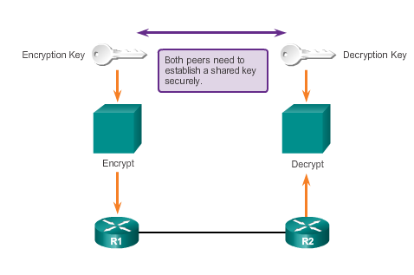
IPsec Framework Diffie-Hellman Key Exchange
Notes:
7.3.2.3 Diffie-Hellman Key Exchange

Slide 33
IPsec Framework Integrity with Hash Algorithms
The original sender generates a hash of the message and sends it with the message itself.
The recipient parses the message and the hash, produces another hash from the received message, and compares the two hashes.
If they are the same, the recipient can be reasonably sure of the integrity of the original message.
Notes:
7.3.2.4 Integrity with Hash Algorithms

Slide 34
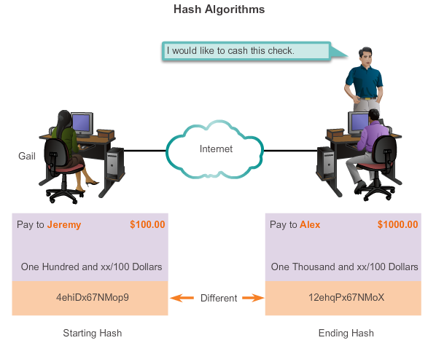
IPsec Framework Integrity with Hash Algorithms (cont.)
Notes:
7.3.2.4 Integrity with Hash Algorithms

Slide 35
IPsec Framework Integrity with Hash Algorithms (cont.)
Hash-based Message Authentication Code (HMAC) is a mechanism for message authentication using hash functions.
HMAC has two parameters: A message input and a secret key known only to the message originator and intended receivers.
Message sender uses an HMAC function to produce a value (the message authentication code) formed by condensing the secret key and the message input.
Message authentication code is sent along with the message.
Receiver computes the message authentication code on the received message using the same key and HMAC function as the sender used.
Receiver compares the result that is computed with the received message authentication code.
If the two values match, the message has been correctly received and the receiver is assured that the sender is a user community member who share the key.
Notes:
7.3.2.4 Integrity with Hash Algorithms

Slide 36
IPsec Framework Integrity with Hash Algorithms (cont.)
There are two common HMAC algorithms:
MD5 – Uses a 128-bit shared secret key. The variable-length message and 128-bit shared secret key are combined and run through the HMAC-MD5 hash algorithm. The output is a 128-bit hash. The hash is appended to the original message and forwarded to the remote end.
SHA – SHA-1 uses a 160-bit secret key. The variable-length message and the 160-bit shared secret key are combined and run through the HMAC-SHA1 hash algorithm. The output is a 160-bit hash. The hash is appended to the original message and forwarded to the remote end.
Notes:
7.3.2.4 Integrity with Hash Algorithms

Slide 37
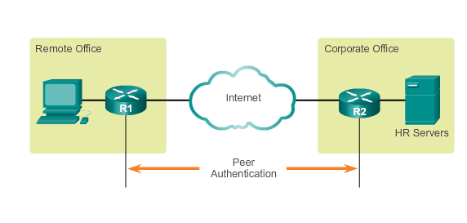
IPsec Framework IPsec Authentication
IPsec VPNs support authentication.
Device on the other end of the VPN tunnel must be authenticated before the communication path is considered secure.
Notes:
7.3.2.5 IPsec Authentication

Slide 38
IPsec Framework IPsec Authentication (cont.)
There are two peer authentication methods, PSK and RSA signatures:
PSK
A secret key shared between the two parties using a secure channel before it needs to be used.
Use symmetric key cryptographic algorithms.
A PSK is entered into each peer manually and is used to authenticate the peer.
Notes:
7.3.2.5 IPsec Authentication

Slide 39
IPsec Framework IPsec Authentication (cont.)
RSA signatures
Digital certificates are exchanged to authenticate peers.
Local device derives a hash and encrypts it with its private key.
Encrypted hash, or digital signature, is attached to the message and forwarded to the remote end.
At the remote end, the encrypted hash is decrypted using the public key of the local end.
If the decrypted hash matches the recomputed hash, the signature is genuine.
Notes:
7.3.2.5 IPsec Authentication

Slide 40
IPsec Framework IPsec Protocol Framework
Authentication Header (AH)
Appropriate protocol to use when confidentiality is not required or permitted.
Provides data authentication and integrity for IP packets that are passed between two systems.
Does not provide data confidentiality (encryption) of packets.
Encapsulating Security Payload (ESP)
A security protocol that provides confidentiality and authentication by encrypting the IP packet.
Authenticates the inner IP packet and ESP header.
Both encryption and authentication are optional in ESP, at a minimum, one of them must be selected.
Notes:
7.3.2.6 IPsec Protocol Framework

Slide 41
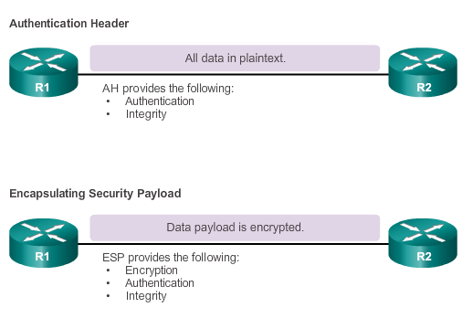
IPsec Framework IPsec Protocol Framework (cont.)
Notes:
7.3.2.6 IPsec Protocol Framework

Slide 42
IPsec Framework IPsec Protocol Framework (cont.)
Four basic building block of the IPsec framework that must be selected:
IPsec framework protocol – A combination of ESP and AH, ESP or ESP+AH options are almost always selected because AH itself does not provide encryption.
Confidentiality (if IPsec is implemented with ESP) – DES, 3DES, or AES, AES is strongly recommended since provides the greatest security.
Integrity – Guarantees that the content has not been altered in transit using hash algorithms (MD5 or SHA).
Authentication – Represents how devices on either end of the VPN tunnel are authenticated (PSK or RSA).
DH algorithm group – Represents how a shared secret key is established between peers, DH24 provides the greatest security.
Notes:
7.3.2.6 IPsec Protocol Framework

Slide 43
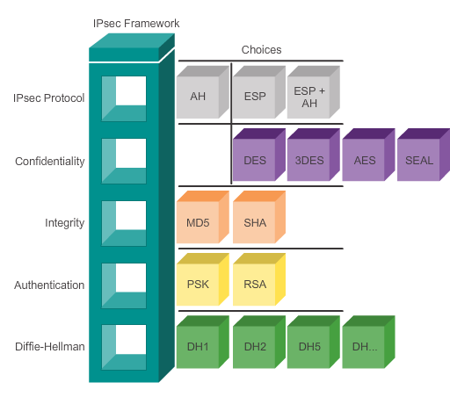
IPsec Framework IPsec Protocol Framework (cont.)
Notes:
7.3.2.6 IPsec Protocol Framework

Slide 44
7.4 Remote Access
Notes:
7.4 Remote Access

Slide 45
Remote Access VPN Solutions Types of Remote Access VPNs
There are two primary methods for deploying remote access VPNs:
Secure Sockets Layer (SSL)
IP Security (IPsec)
Type of VPN method based on the access requirements of the users and the organization’s IT processes.
Both types offer access to virtually any network application or resource.
Notes:
7.4.1.1 Types of Remote Access VPNs

Slide 46
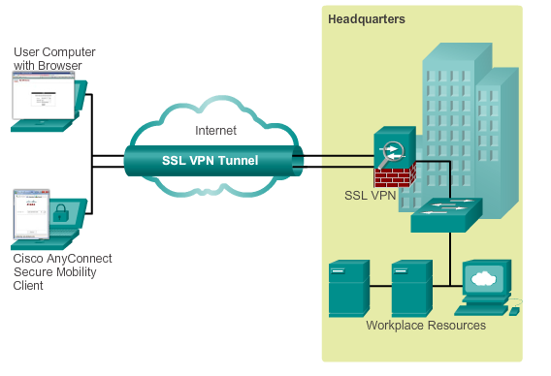
Remote Access VPN Solutions Cisco SSL VPN
Provides remote access by using a web browser and the web browser’s native SSL encryption.
Can provide remote access using the Cisco AnyConnect Secure Mobility Client software
Notes:
7.4.1.2 Cisco SSL VPN

Slide 47
Remote Access VPN Solutions Cisco SSL VPN Solutions
Cisco AnyConnect Secure Mobility Client with SSL
Client-Based SSL VPNs provide authenticated users with LAN-like, full network access to corporate resources
The remote devices require a client application, such as the Cisco VPN Client or the newer AnyConnect client to be installed on the end-user device
Cisco Secure Mobility Clientless SSL VPN
Enables corporations to provide access to corporate resources even when the remote device is not corporately-managed
Cisco ASA is used as a proxy device to network resources
Provides a web portal interface for remote devices to navigate the network using port-forwarding capabilities
Notes:
7.4.1.3 Cisco SSL VPN Solutions

Slide 48
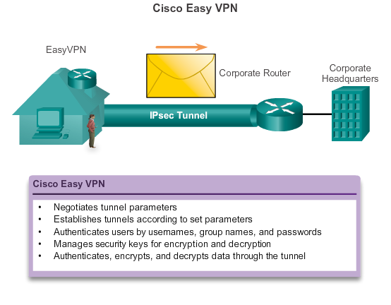
IPsec Remote Access VPNs IPsec Remote Access
Notes:
7.4.2.1 IPsec Remote Access

Slide 49
IPsec Remote Access VPNs IPsec Remote Access (cont.)
The Cisco Easy VPN solution consists of three components:
Cisco Easy VPN Server – A Cisco IOS router or Cisco ASA Firewall acting as the VPN head-end device in site-to-site or remote-access VPNs.
Cisco Easy VPN Remote – A Cisco IOS router or Cisco ASA Firewall acting as a remote VPN client.
Cisco VPN Client – An application supported on a PC used to access a Cisco VPN server.
The Cisco Easy VPN solution feature offers flexibility, scalability, and ease of use for both site-to-site and remote access IPsec VPNs.
Notes:
7.4.2.1 IPsec Remote Access

Slide 50
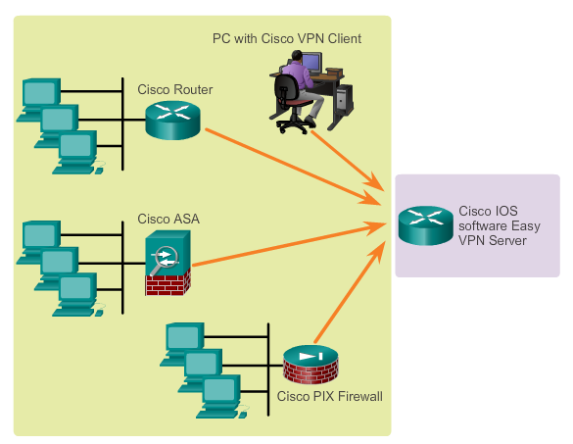
IPsec Remote Access VPNs Cisco Easy VPN Server and Remote
Notes:
7.4.2.2 Cisco Easy VPN Server and Remote

Slide 51
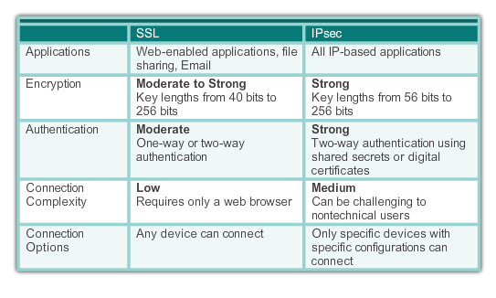
IPsec Remote Access VPNs Comparing IPsec and SSL
Notes:
7.4.2.4 Comparing IPsec and SSL

Slide 52
Chapter 7: Summary
VPNs are used to create a secure end-to-end private network connection over a third-party network, such as the Internet.
A site-to-site VPN uses a VPN gateway device at the edge of both sites. The end hosts are unaware of the VPN and have no additional supporting software.
A remote access VPN requires software to be installed on the individual host device that accesses the network from a remote location.
The two types of remote access VPNs are SSL and IPsec.
SSL technology can provide remote access using a client’s web browser and the browser’s native SSL encryption.
Using Cisco AnyConnect software on the client, users can have LAN-like, full network access using SSL.
Notes:
Chapter 7 Summary

Slide 53
Chapter 7: Summary (cont.)
GRE is a basic, non-secure site-to-site VPN tunneling protocol that can encapsulate a wide variety of protocol packet types inside IP tunnels, thus allowing an organization to deliver other protocols through an IP-based WAN.
Today, it is primarily used to deliver IP multicast traffic or IPv6 traffic over an IPv4 unicast-only connection.
IPsec, an IETF standard, is a secure tunnel operating at Layer 3 of the OSI model that can protect and authenticate IP packets between IPsec peers.
It can provide confidentiality by using encryption, data integrity, authentication, and anti-replay protection.
Data integrity is provided by using a hash algorithm, such as MD5 or SHA.
Authentication is provided by the PSK or RSA peer authentication method.
Notes:
Chapter 7 Summary

Slide 54
Chapter 7: Summary (cont.)
The level of confidentiality provided by encryption depends on the algorithm used and the key length.
Encryption can be symmetrical or asymmetrical.
DH is a method used to securely exchange the keys to encrypt data.
Notes:
Chapter 7 Summary

Slide 55


Slide 56
Review
IPsec VPN
Created an IPSec based Virtual Private Network (VPN) for a company to connect with its partner's network securely. The data transmitted is authenticated and encrypted over the Internet so Confidentiality, Integrity, and Availability can be achieved.
Configuration includes:
Type of VPN: IPsec tunnel
Tunnel policy: Internet Security Association and Key Management Protocol (ISAKMP-IKEv2)
Failover plan: Port-Channel and Double-Homed Single ISP (WAN topology)
Packet filter: Extended Access-List
IP addressing scheme: Internet Protocol Version 4 (IPv4)

Slide 57
IPsec VPN
Virtual Private Network (VPN) is a secure logical network that a company or user required while confidential data need to be transmitted securely from one device to another over the Internet.
Internet is loaded with unauthorized users trying to break down your company's security and pushing data over such an unsecured network without a VPN or personal leased line would be questionable once the security threat occurs. VPNs have different flavors available for you, so you can find the best solution and implement it into your network for end-to-end security.
Project : IPsec-VPN-project.pkt
Organisation requires establishing a VPN between a host in its parts division and a host in the manufacturing department of one of their business partners, TheirCo. They only want to create a VPN between System-A and System-C (refer to the figure), so that no other devices from both networks will be connecting except these two.

Slide 58
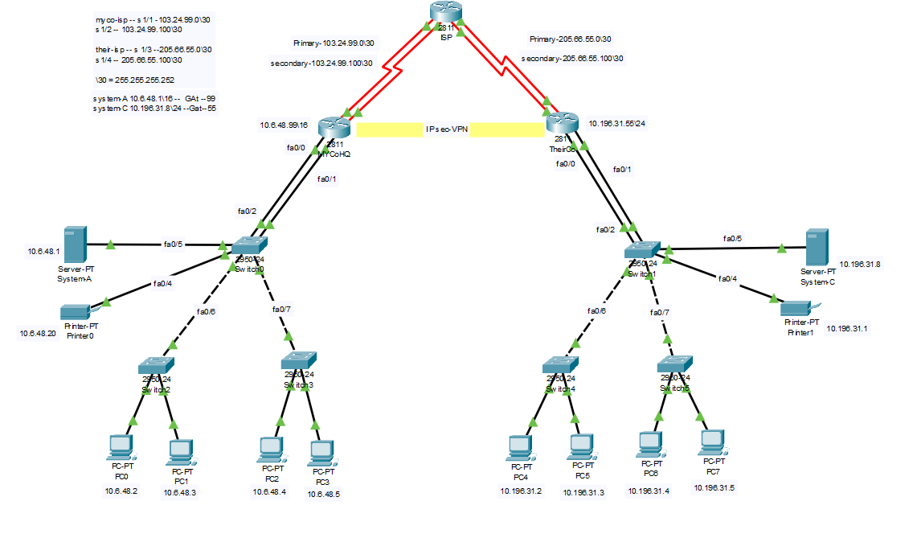
IPsec VPN

Slide 59
IPsec VPN
Solusion
IPsec VPN and ISAKMP policies were created between two routers with Pre-shared Key authentication and encryption (AES 256).
Access-list created to filter the traffic, so only System-A and System-C can connect between these two networks.
Port-Channel had been between Router-to-Switch. for high-speed and redundancy.
Two Serial links have been used to connect with ISP. This will allow high-availability and if one goes down them the other link will be up. To enable this feature, the Administrative Distance of the route of the back-up link was increased

Slide 60
Port Address Translation
PAT stands for Port Address Translation which is a feature on network devices that allows multiple users to use the same Public IP address from that private network. It is an extended form of Network Address Translation.
As the numbers of the network device are increasing constantly, the demand for the IP addresses is increased too. Hence, the solution for not running out from IP addresses includes PAT, NAT, and IPv6. Use of PAT in the network reduces the operational cost, as the least or no extra IP addresses will require to lease from Internet Service Provides.
Project : "Network-Port-Address-Translation.pkt
A simple network scenario is created to demonstrate how PAT can be implemented on the network. This project also concentrates on features like Dynamic Host Configuration (DHCP) and Access control Lists (ACLs). The DHCP will allow us to automatically provide the IP addresses to the network devices and ACL will make sure that only authorised network/users are accessing the company's network. Simply, ACLs are a type of filtration occurring whenever any packet leaves/enters the private network.

Slide 61
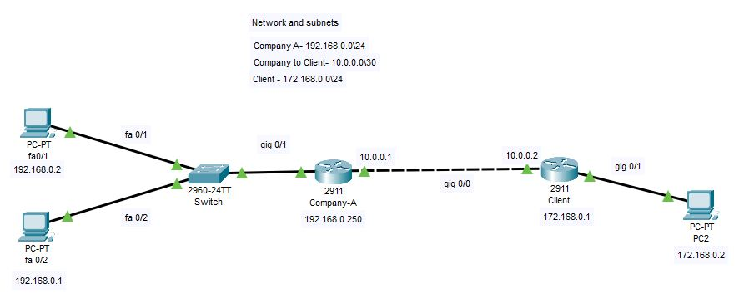
Port Address Translation

Slide 62
VPN-Tunnel
https://www.cisco.com/c/en/us/support/docs/security/asa-5500-x-series-firewalls/215884-configure-a-site-to-site-vpn-tunnel-with.html
https://idwebhost.com/blog/vpn-tunnel/

Slide 63
VPN-For-Remote-Access
Why use a VPN ?
Privacy and Anonymity: VPNs hide a user's browser history, IP address, and geographical location, enhancing security and preventing unauthorized access to personal data.
Bypassing Geographical Restrictions: VPNs enable access to restricted content based on location, allowing users to visit otherwise unavailable websites.
Remote Access: VPNs provide secure remote access to a company's network, facilitating work from home or while traveling.
Public WiFi Security: VPNs protect users on public WiFi networks from hackers and cybercriminals attempting to intercept sensitive information.
How VPNs Work
Tunneling Protocols: VPNs utilize tunneling protocols like OpenVPN, SSTP, and IKEv2 for data encryption and decryption.
Encryption: VPNs use encryption to secure data transmitted over the internet, preventing unauthorized reading without the decryption key.
IP Address Masking: VPNs replace a user's IP address with that of the VPN server, maintaining anonymity and preventing tracking.
Types of VPNs
Remote Access VPNs: Allow individual users to securely connect to a private network over the internet.
Site-to-Site VPNs: Connect entire networks in different locations, ensuring secure communication between them.
Hardware VPNs: Physical devices providing VPN functionality, commonly used for added security in enterprise environments.

Slide 64
VPN-For-Remote-Access
Cisco 1941 Routers
High-Performance Routing: Known for high-performance capabilities suitable for routing tasks.
Scalability: Offers scalability to accommodate growing network needs.
Security Features: Advanced security features for firewall capabilities, access control, and VPN support.
Modular Design: Flexibility in adding modules for specific functionalities.
Reliability: Ensures uninterrupted connectivity and minimizes downtime.
Cisco 2960-24 Switch
Network Switching: Used for local network switching, providing high-performance and low-latency communication.
Port Density: With 24 ports, accommodates numerous devices within the local network.
Battery Backup: Ensures continuous power supply, crucial for maintaining network operations during power outages.
Server
The server serves various purposes, contributing to the overall functionality, efficiency, and management of the network:
Centralized Resource Hosting
User Authentication and Authorization
Network Services
Data Storage and Backup
Application Hosting
Security Management
Power Resilience and Controlled Shutdown
Centralized Updates and Patch Management
Network Administration and Monitoring

Slide 65
VPN-For-Remote-Access
Working
Network Connectivity
The Cisco 1941 routers are responsible for routing traffic within your network. They facilitate communication between different subnets and connect your local network to the internet.
VPN Tunnel Configuration
The routers are configured to establish an IPSec VPN tunnel between them. This tunnel allows secure communication between the routers, even if they have duplicate LAN subnets. The VPN ensures that data exchanged between the routers is encrypted and secure.
Switching and Local Network Connectivity
The Cisco 2960-24 switch is used for local network switching. It provides efficient communication between devices within your local network, allowing devices to connect, communicate, and share resources seamlessly.
Server Functionality
The server serves as a centralized hub for hosting various resources, including applications, databases, and shared files. It provides a platform for user authentication and authorization, ensuring secure access to network resources.
Accessing Server from Worker 1
Insert specific details on how to access the server from Worker 1.

